Slide 1
TERM PROJECT
Nageswararao Bobbala

Slide 2
Data Set and 5 variables
For this project, I have selected Covid-19 World Vaccination Progress data set to perform Exploratory Data Analysis.
Name of the file - country_vaccinations.csv
Five variables that were used during the analysis are as follows
LeadCountries
LeadPeople
LeadFulPeople
PopVaccinated
PopFullyVaccinated

Slide 3
Purpose of the each of the variable is different and unique. These variables were used for effective analysis of the data set
LeadCountries - This variable holds the countries leading by the total vaccinations
LeadPeople - This variable holds the countries leading by the people_vaccinated
LeadFulPeople – This variable holds the countries leading by the people_fully_vaccinated
PopVaccinated – This variable is used to determine the number of people vaccinated per hundred
PopFullyVaccinated – This variable is used to determine the number of people fully vaccinated per hundred

Slide 4
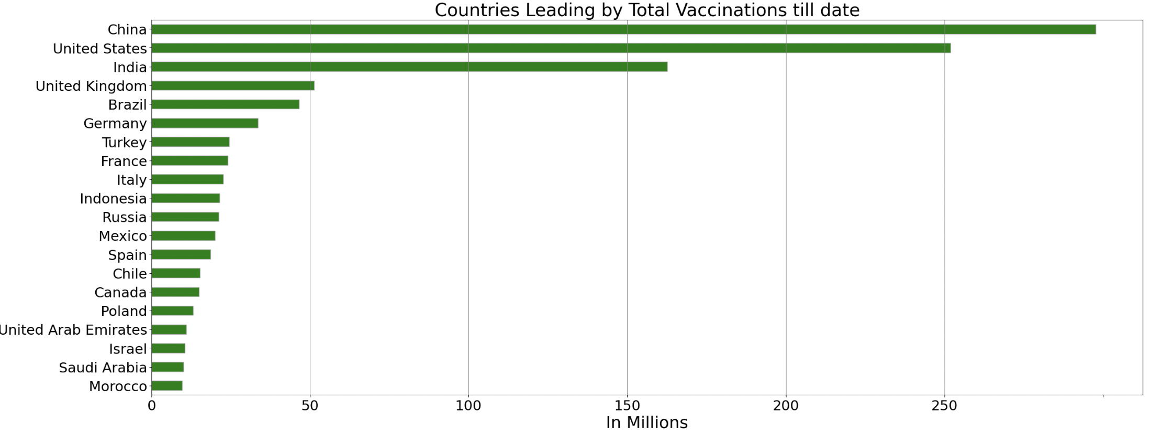
Histogram with LeadCountries variable
From this histogram we can see that the china is leading followed by United states and India for the total number of vaccinations done till date.

Slide 5
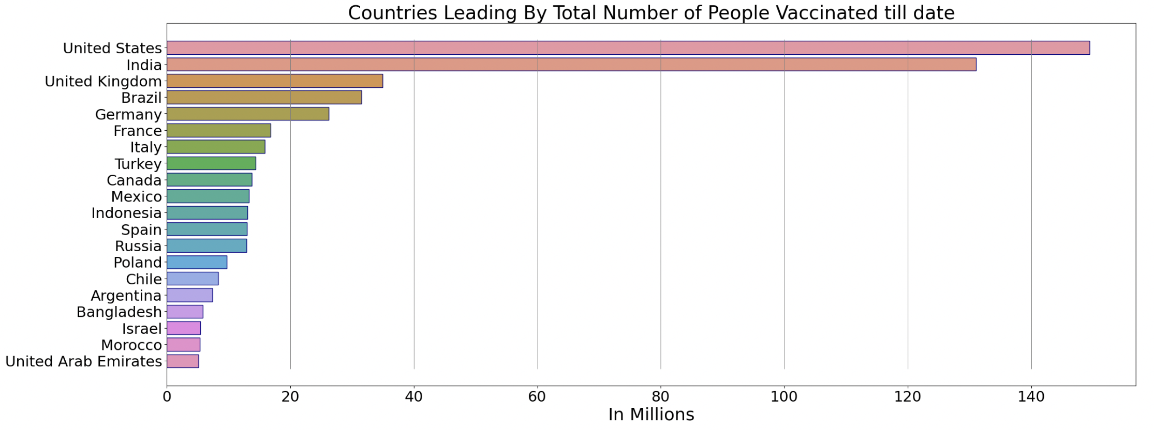
Histogram with LeadPeople variable
From this histogram, we can see that the China is not listed in the top countries that was leading by the total number of people vaccinated. This is due to fact that data for the china is not available for the people vaccinated column in the data set.
Based on the data, we can see that the United states, India and United kingdom topped in vaccinating people in their countries.

Slide 6
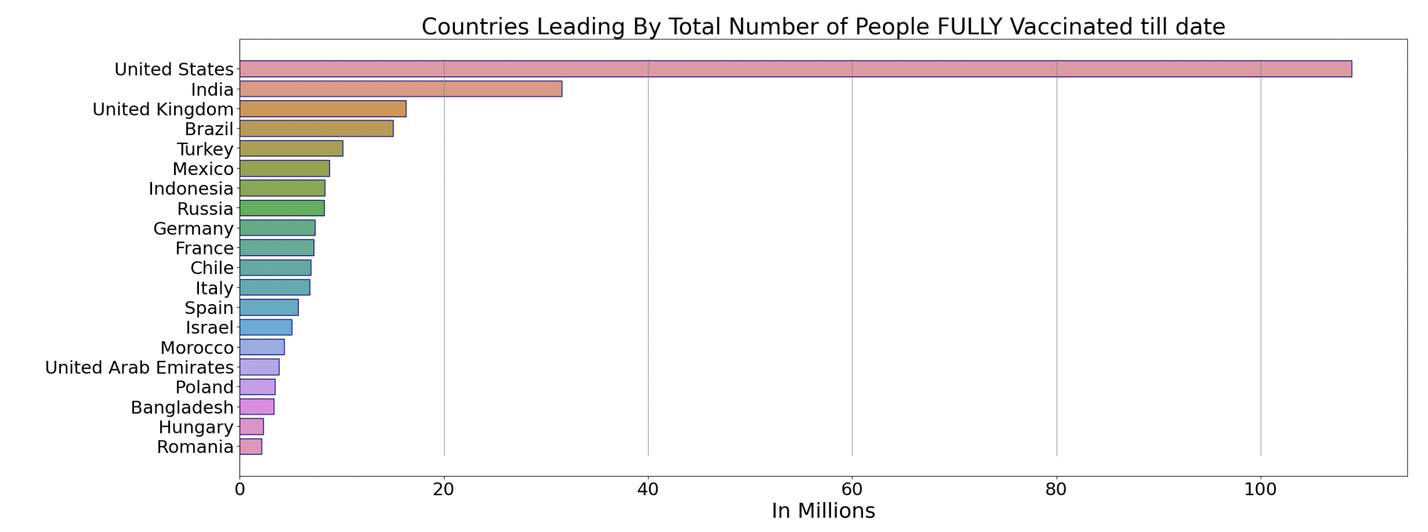
Histogram with LeadFulPeople variable
Without China data, top 4 countries that were leading with the number of people vaccinated and number of people fully vaccinated are same.
Top 5 countries that were leading with the fully vaccinated people are United states, India, United Kingdom, Brazil and Turkey.

Slide 7
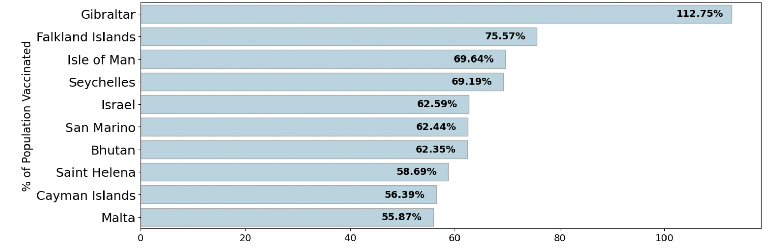
Histogram with PopVaccinated variable
From the Histogram, we can see that Gibraltar has recorded highest number of people vaccinated
For remaining nine countries, percentage of population that is vaccinated is very close which is greater than 55%

Slide 8
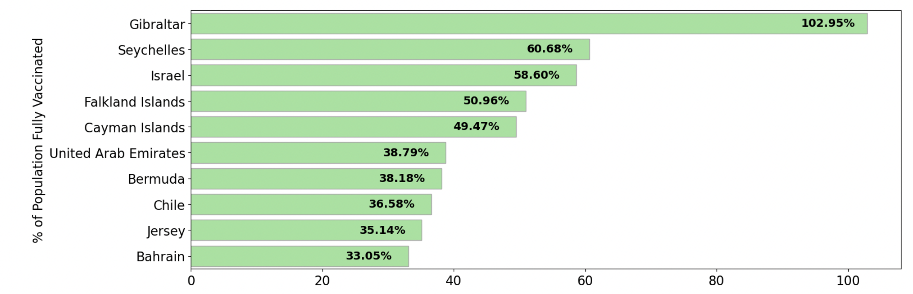
Histogram with PopFullyVaccinated variable
From this histogram, again Gibraltar recorded highest number of population with fully vaccination which is 102.95%
Remaining nine countries, percentage of population that were fully vaccinated were very less with difference in 50%.

Slide 9
Outliers
An outlier is something that is different from all other values.
These outliers can be due the mistake resulted during data collection, or it can be just an indication of data variance, or it can be accurate value that was resulted from rare event.
From histogram, we can only identify the most common values but is not possible to identify rare values.
Handlings of the outliers depends on the domain knowledge and the analysis that we are trying to perform
These outliers can be detected mostly during data cleaning process and can be handled mostly by replacing such outliers with the estimates if those outliers were caused due to mistake in measurements.

Slide 10
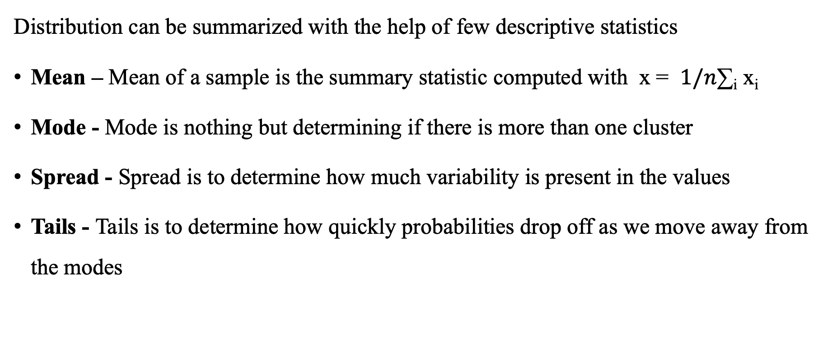
Characteristics of the variables
Distribution can be summarized with the help of few descriptive statistics
Mean – Mean of a sample is the summary statistic computed with x = $1/n$∑_{i} x_{i}
Mode - Mode is nothing but determining if there is more than one cluster
Spread - Spread is to determine how much variability is present in the values
Tails - Tails is to determine how quickly probabilities drop off as we move away from the modes

Slide 11
PROBABILITY MASS FUNCTIONS(Pmfs)
One way to represent distribution is the use of probability mass function, which maps from each value to its probability.
Probability is nothing but the frequency expressed as a fraction of the sample size.
If hist is given, we can make a dictionary that maps each value to its probability.
n = hist.Total()
d = {}
for x, frequency in hist.Items():
d[x] = frequency/n
Difference between hist and pmfs is that the hist maps from values to integer counters whereas pmfs maps from values to floating point probabilities.

Slide 12
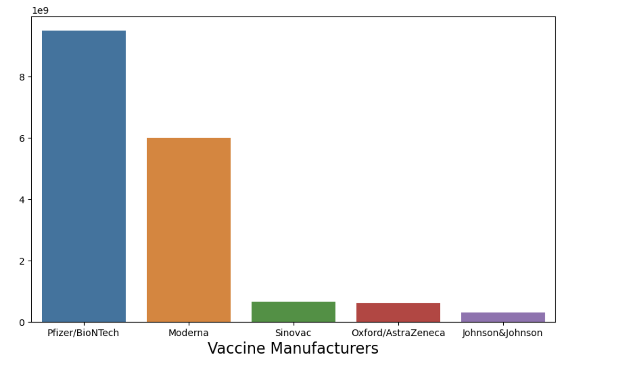
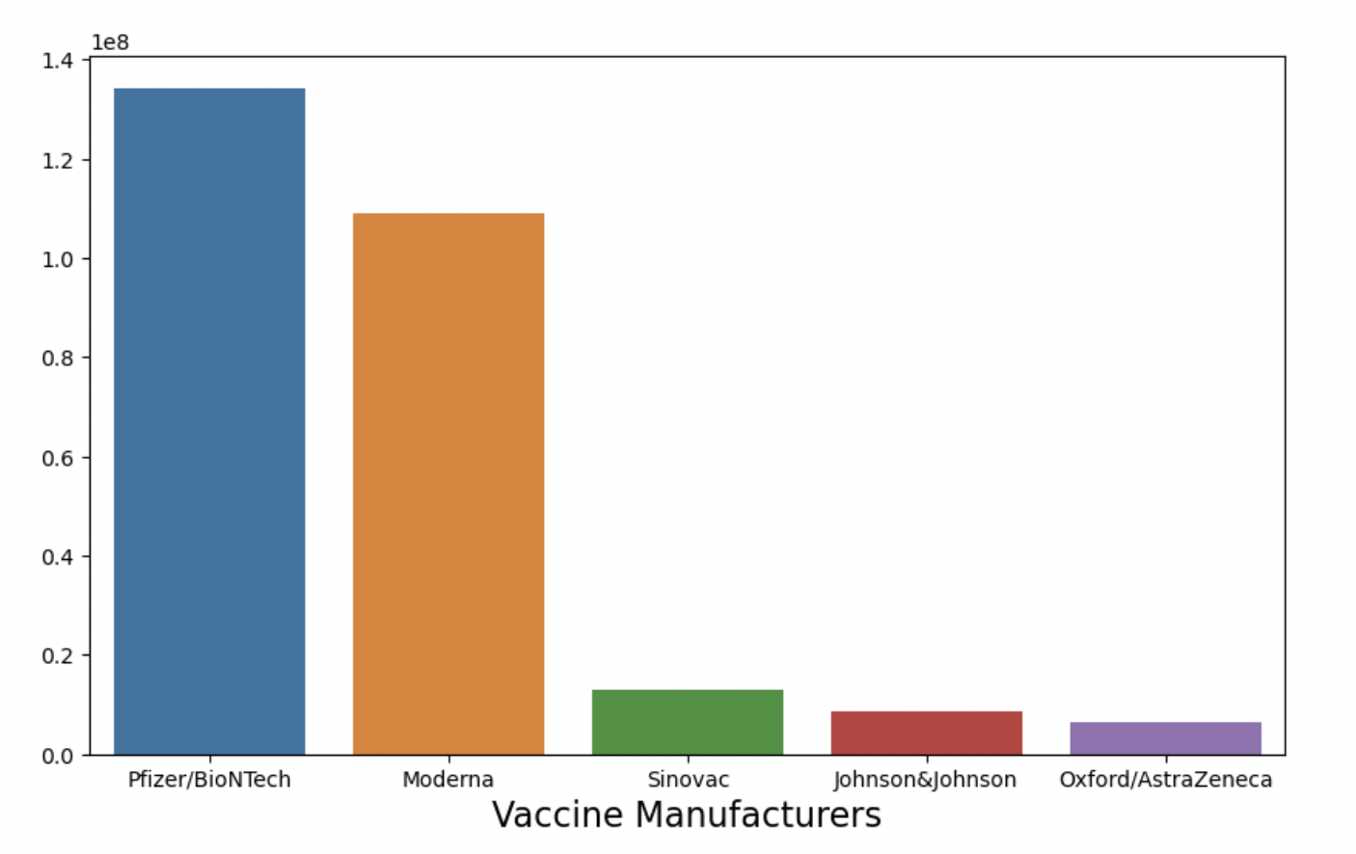
PMF plotting of two scenarios with the same variable

Slide 13
Cumulative Distribution Functions
Cumulative Distribution function is a function which maps from a value to its percentile rank.
CDF is a function of x which corresponds to any value from the distribution
To compute CDF(x) for some value of x, need to evaluate the fraction of values in the distribution less than or equal to x
CDF can be evaluated for any value of x and does not limit to the values that appear in the sample.
CDFs are useful mainly for comparing distributions.

Slide 14
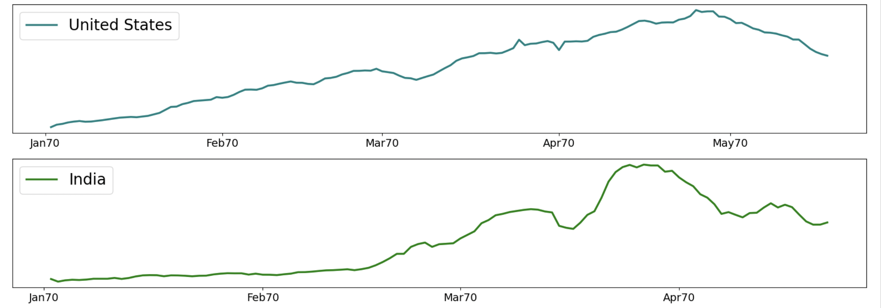
Plotting CDFs

Slide 15
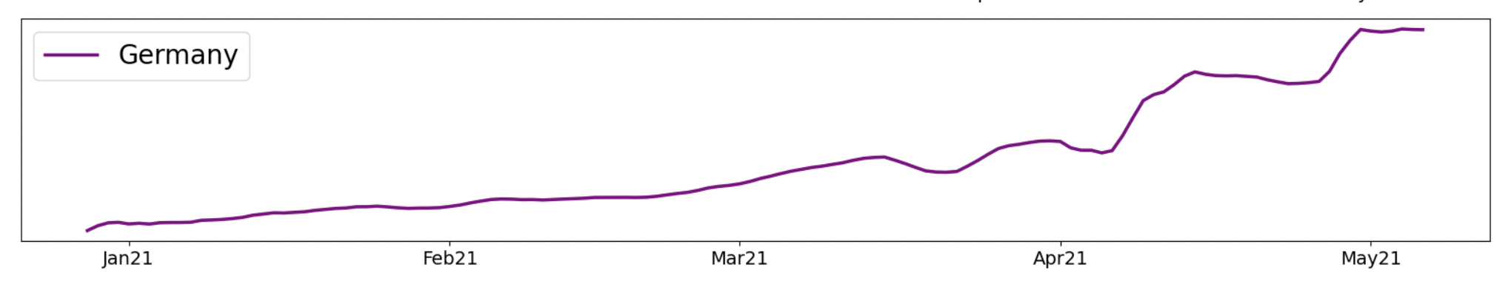
Analytical Distribution
Analytical distributions are characterized by CDF which is a mathematical function like exponential, logarithmic functions etc.
In this model, unnecessary details were left out.

Slide 16
Regression Analysis
The linear least square fit is an example of regression which helps in fitting any kind of model to any kind of data.
Main aim of regression analysis is to describe relationship between one set of variables called dependent variables and another set of variables called independent variables or explanatory variables.
If the relationship between dependent and independent variable is linear then it is linear regression.
If there is more than one explanatory variable, then it is multiple regression.

Slide 17
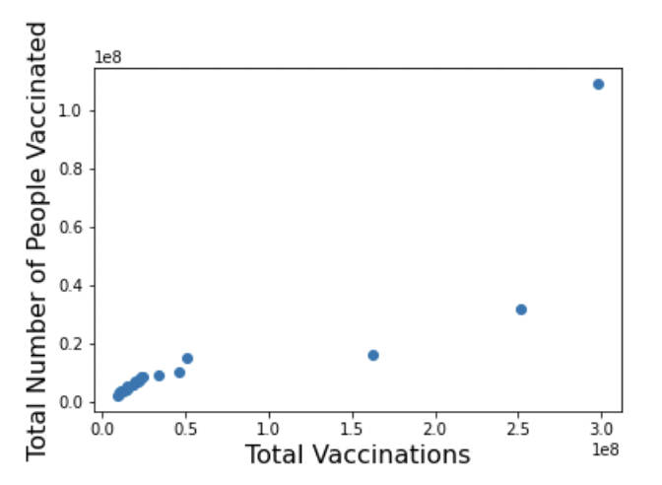
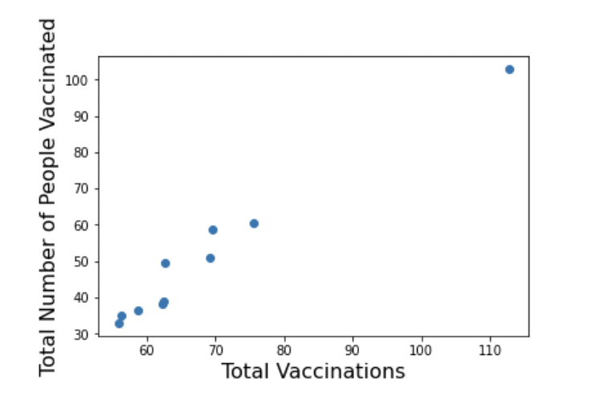
Scatter plots

Slide 18
Scatter plots and Correlation
Relationship between two variables can be checked easily with the help of scatter plots.
Plotted scatter plots for the two variables LeadCountries and LeadFulPeople are not the best representation of the data as data are packed into columns.
Problem here is that values of the total_vaccinations has huge range of values due to which some information is lost.
Challenge faced in measuring correlation is due to the fact that the two variables that we were comparing and not in similar units

